Slide 1
IAF 601: Predictive Analytics Final Presentation
Vathana Him
Andrew Lindberg
Dajonna Williams
Oluwafunke Folarin

Slide 2
Impact of Socioeconomic factors on House Prices in North Carolina

Slide 3
Table Of Contents
01
02
03
04
Introduction
Exploration
Regression Analysis
Conclusion

Slide 4
Introduction

Slide 5
Main Purpose
Social Factors
Living through uncertain economic times caused by the pandemic
Millennials have been impacted by two economic recessions in their lifetime
Many are now of age to look for a house, while others age group struggle with mortgage payments
Informed Decision Making
Establish relationship between socioeconomic factors and its impact on the housing market
Allow buyer to see when is the best time to buy a house
Provide support for those in need of housing assistance
Desired Outcome
Gain insight into the house market for future economic crashes

Slide 6


Data Retrieval/Cleaning
Data Source
Economic Research Federal Reserve Bank of St. Louis
U.S Bureau of Labor Statistics
Data Preparation
House price data was grouped by date by taking the sum and average of the sum (due to split by region mame column)
Date was formatted in Y-M-D
Weekly wage, labor force rate, unemployment and house price data was joined by using date as the key
Removed all NA values

Slide 7
Exploration

Slide 8

Predictor Variables Targeted
Labor Force Rate
Dates
Average Weekly Wage
Unemployment Rate
Number of all employed and unemployed workers divided by civilian population
Total 01/2007-08/2020
2008 Recession 12/2007-06/2009
Average Weekly Wage in North Carolina
Rate of workforce who are out of work

Slide 9

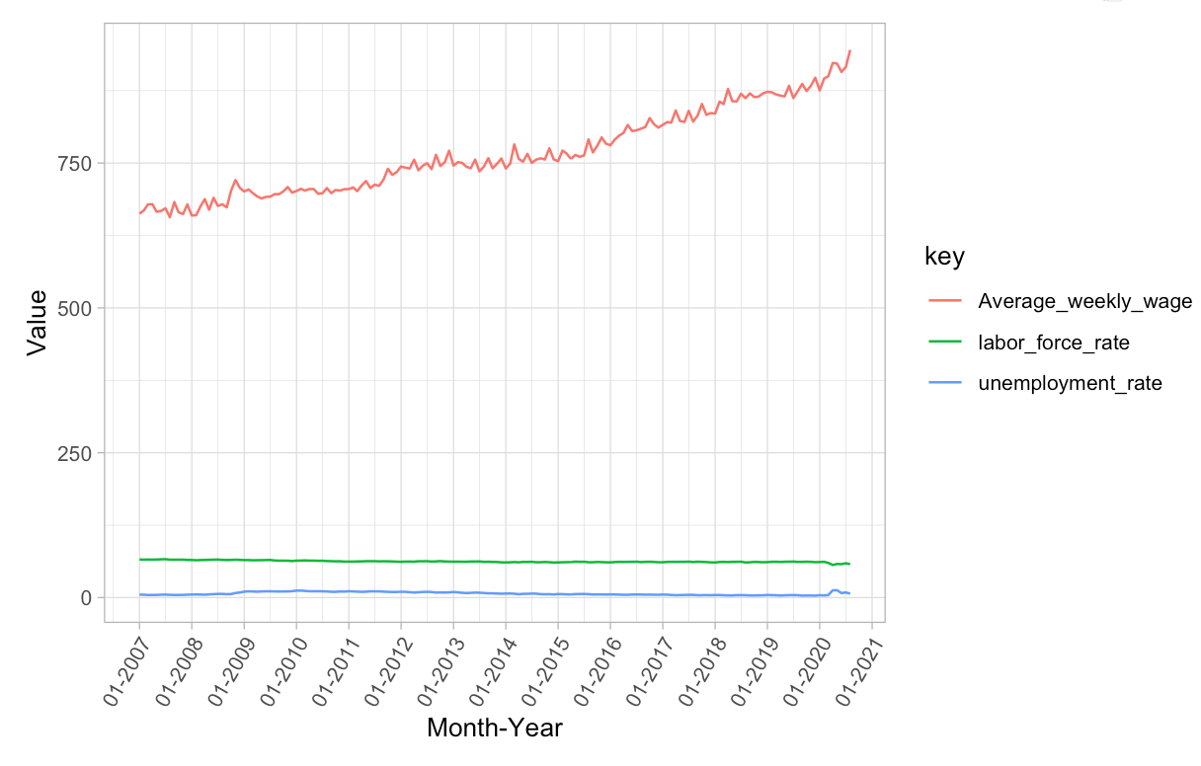
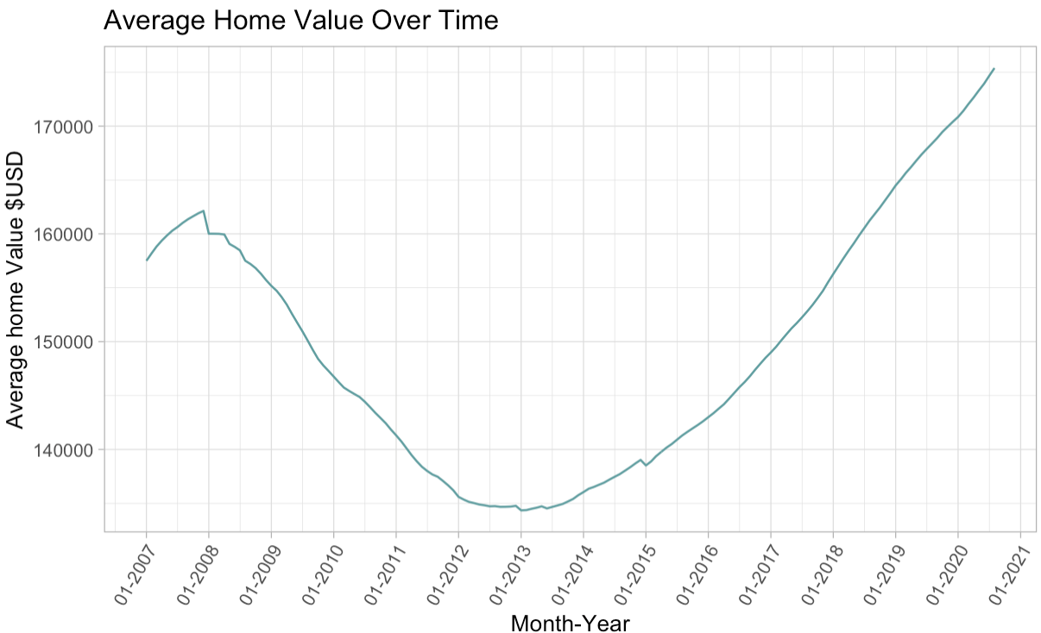
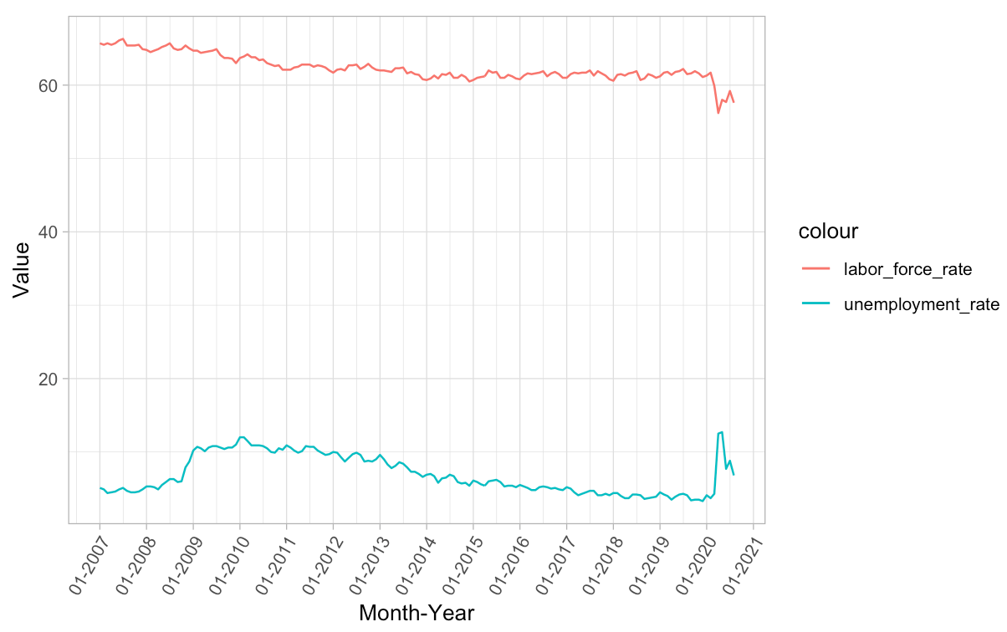
Visualization Exploration
Predictor Variables Overtime in NC
Average Home Value Overtime In NC
Predictor Variables Overtime in NC

Slide 10
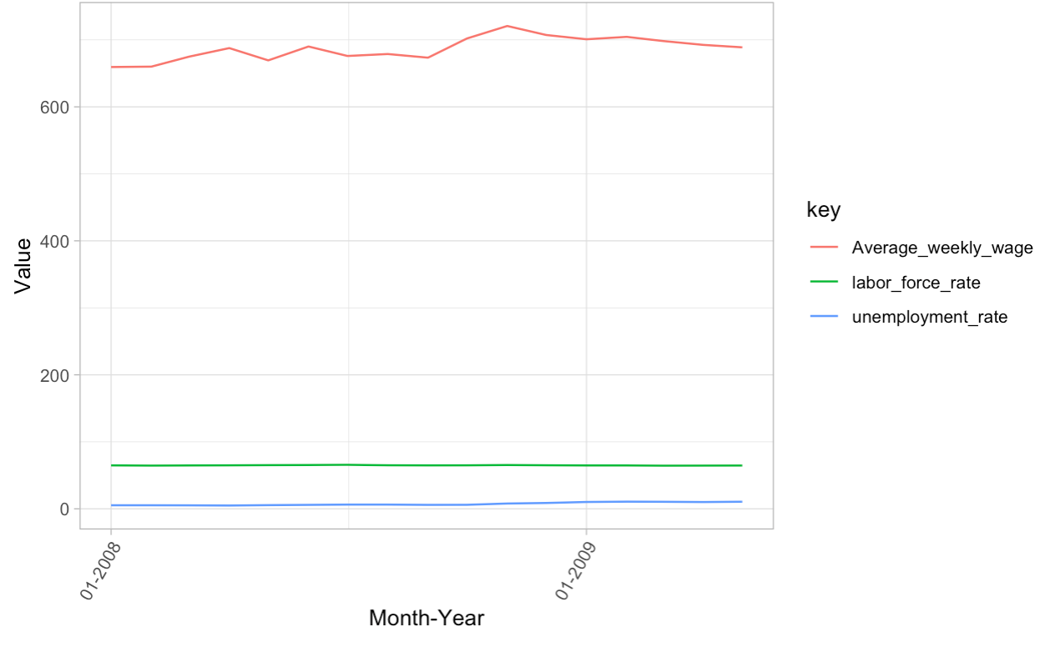
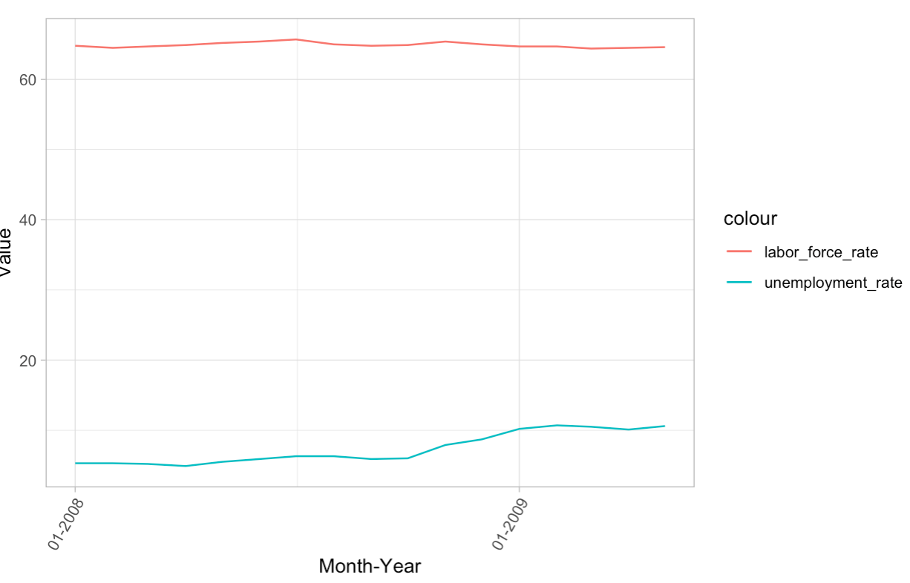
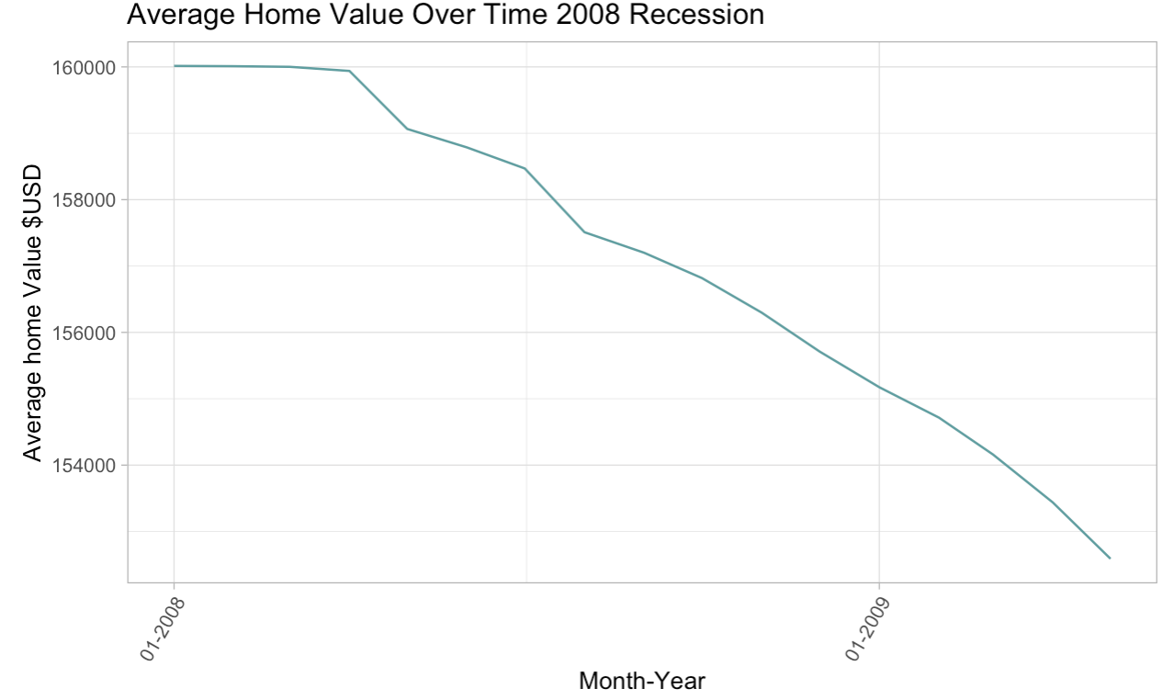
Visualization Exploration 2008 Recession
Predictor Variables Overtime in NC
Predictor Variables Overtime in NC
Average Home Value Overtime In NC

Slide 11
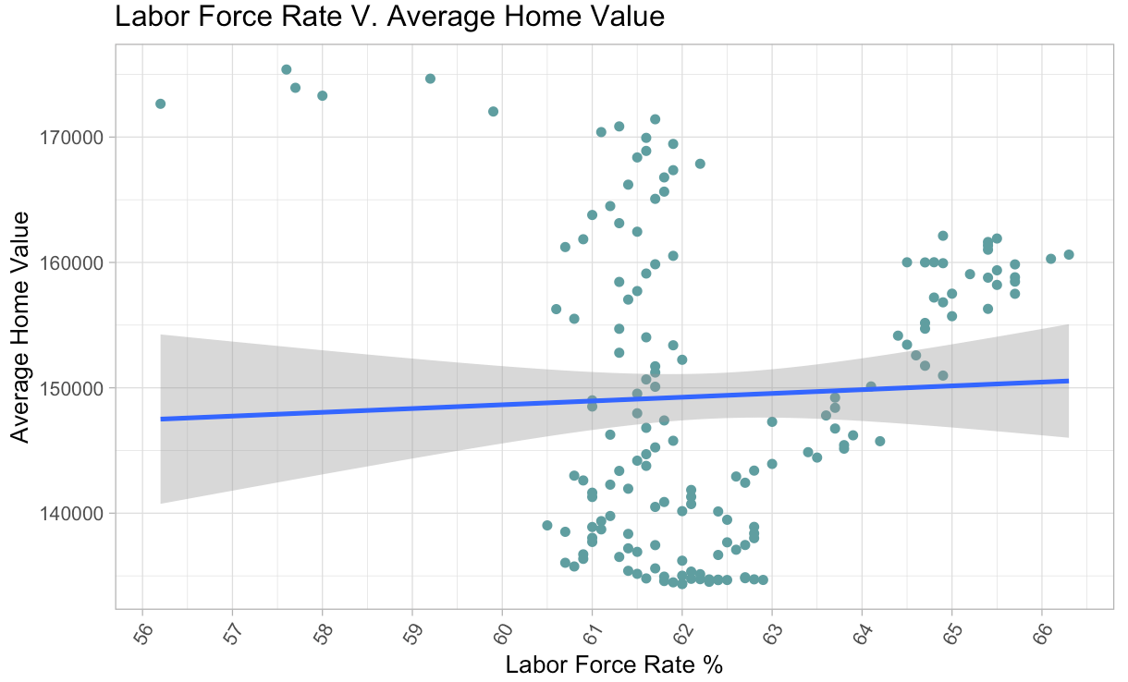
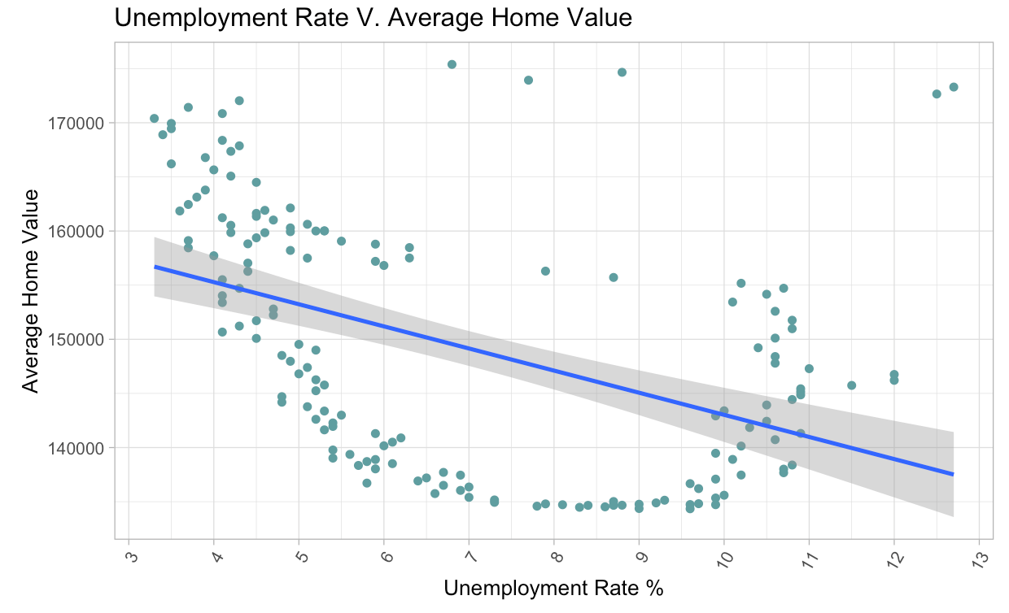
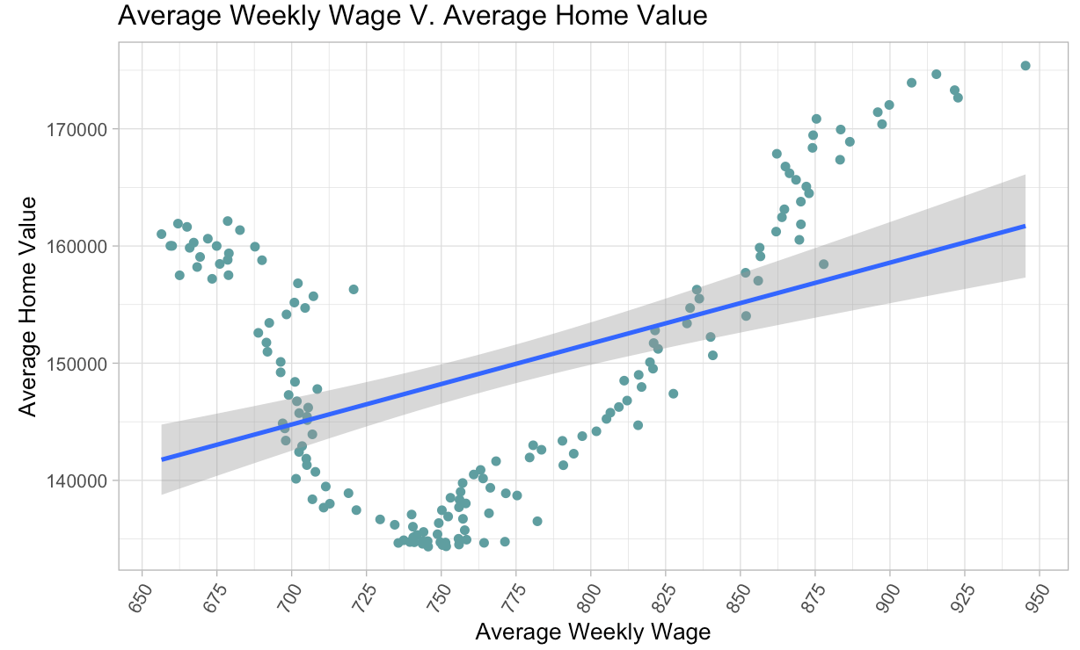
Preliminary Analysis
Labor Force Rate V. Average Home Value
Average Weekly Wage V. Average Home Value
Unemployment Rate V. Average Home Value

Slide 12
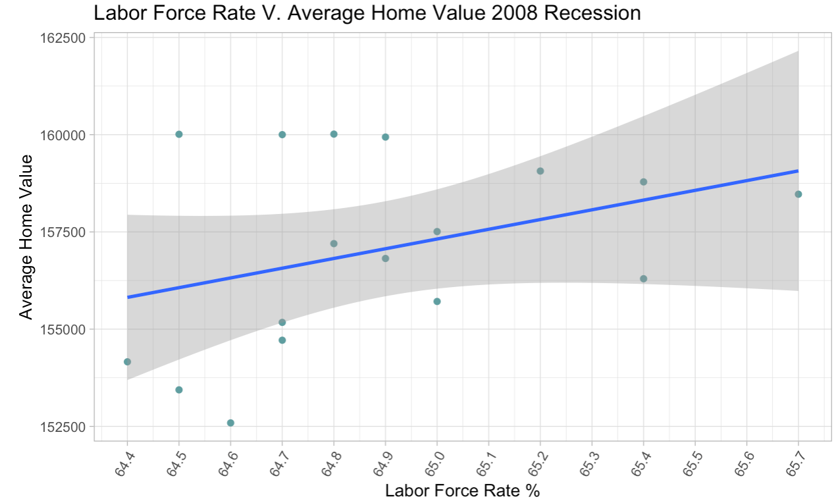
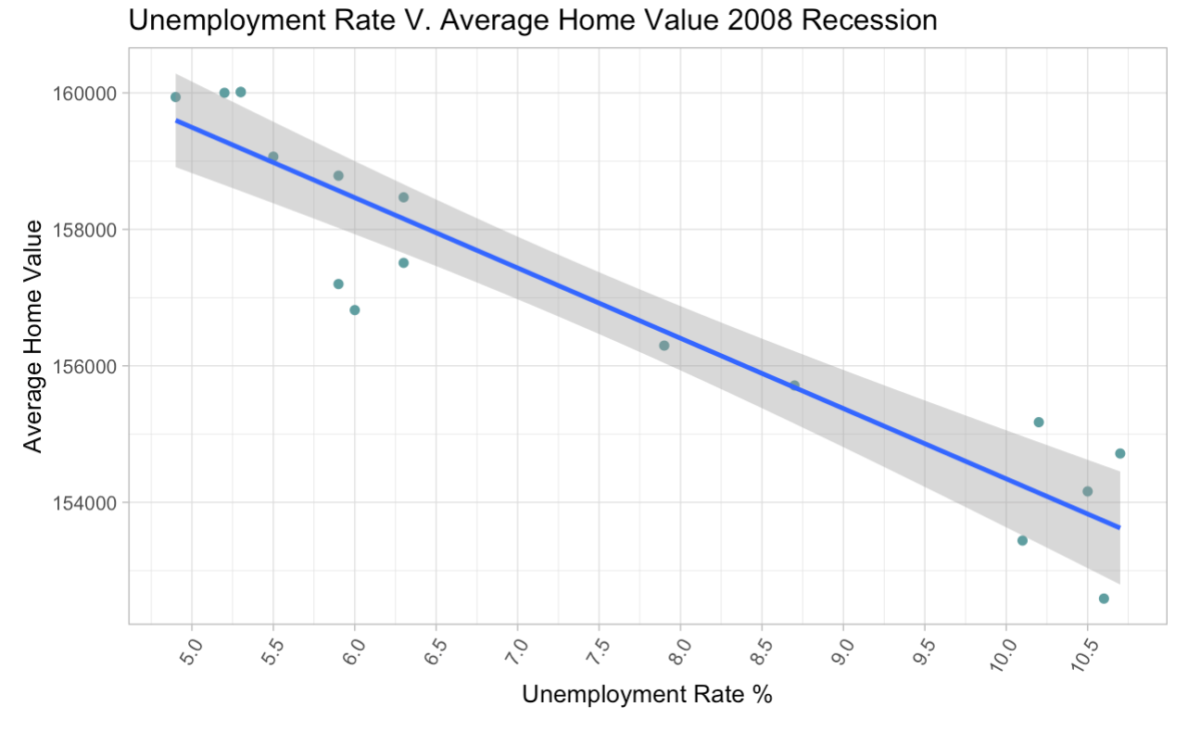
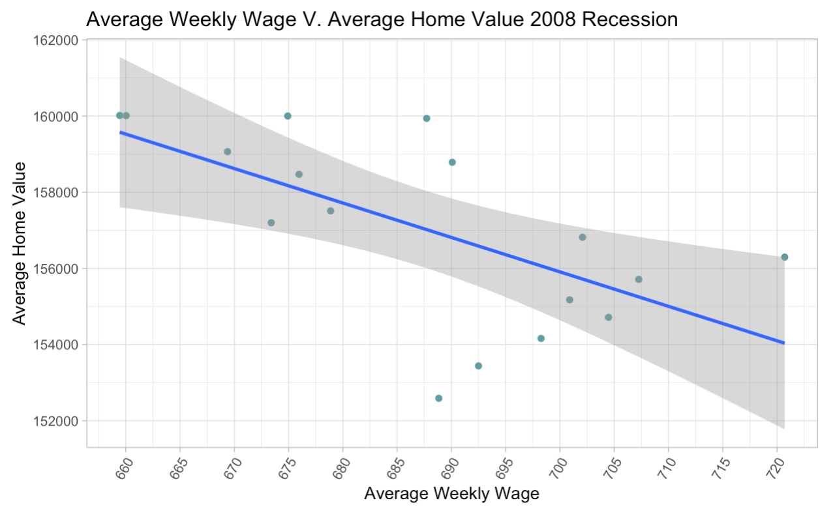
Preliminary Analysis 2008 Recession
Labor Force Rate V. Average Home Value
Average Weekly Wage V. Average Home Value
Unemployment Rate V. Average Home Value

Slide 13
Regression Analysis

Slide 14
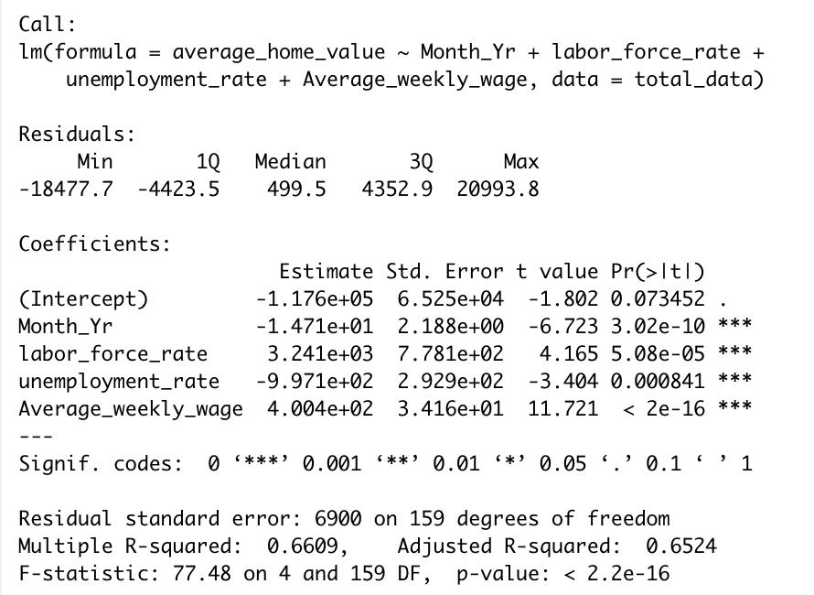
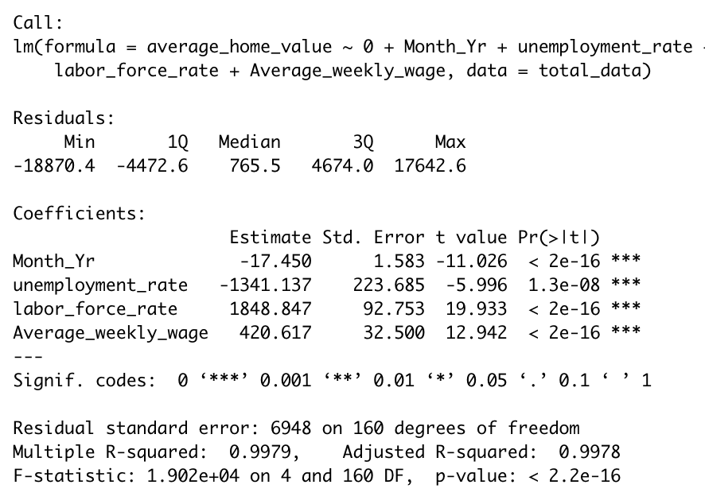
Without Interaction Variable
Included Zero Term
Excluded Zero Term

Slide 15
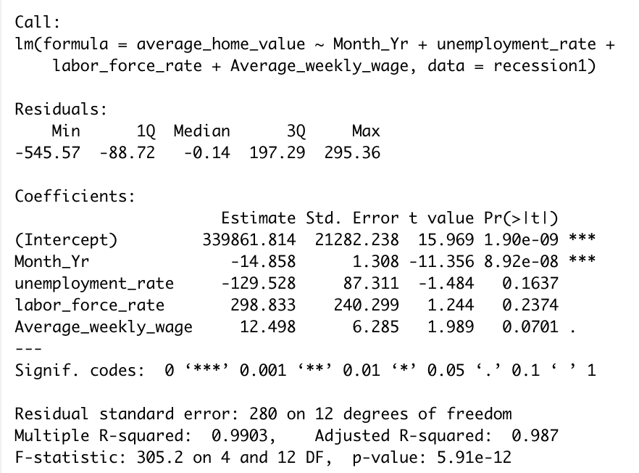
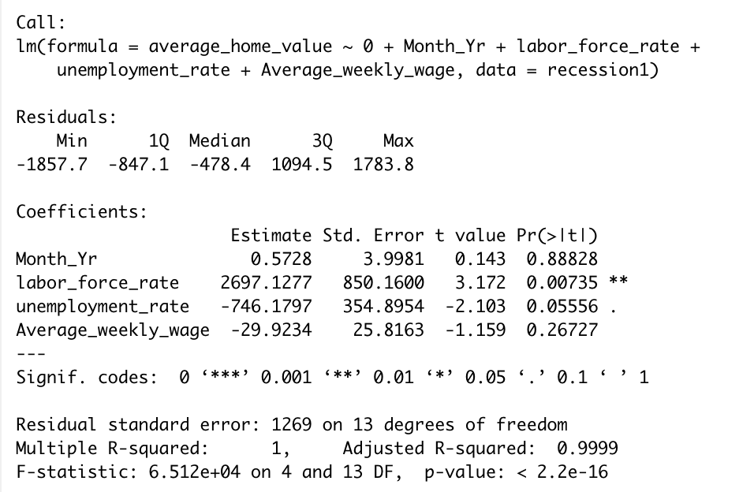
Without Interaction Variable 2008 Recession
Included Zero Term
Excluded Zero Term

Slide 16
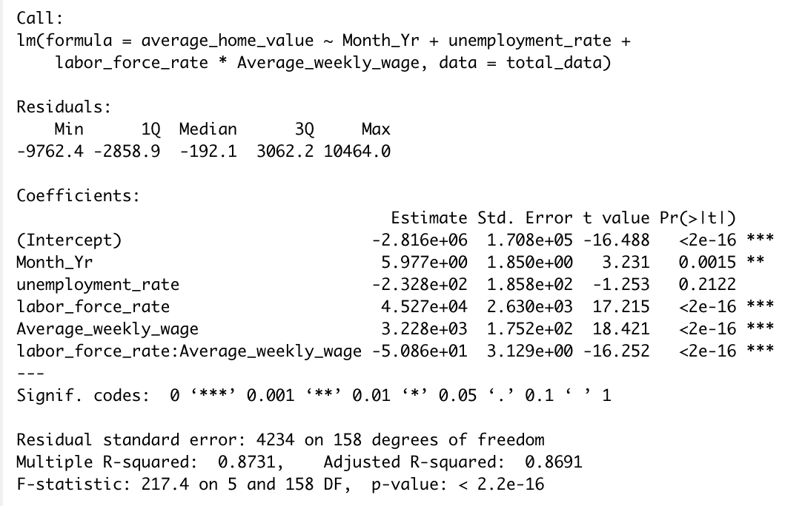
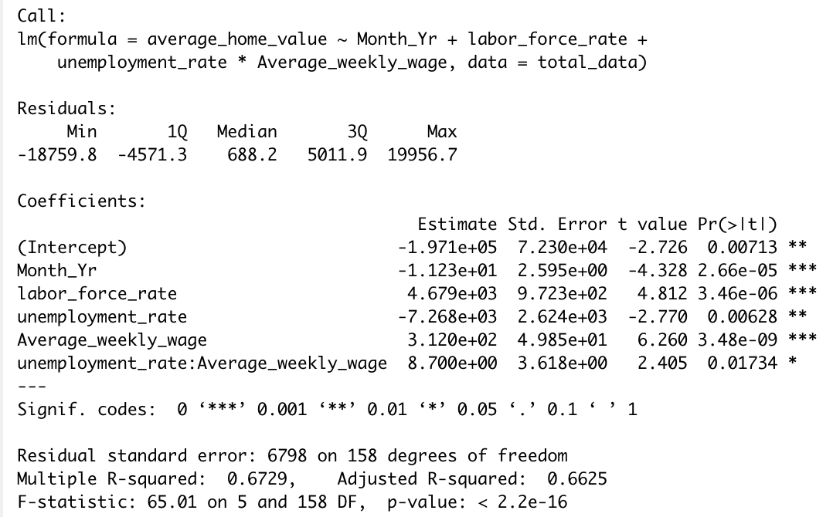
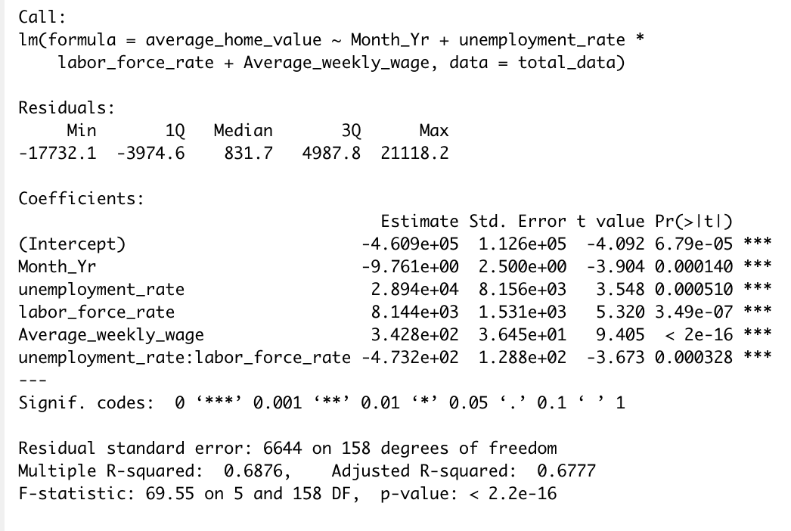
With Interaction Variable
Model 2: Interaction between labor force and Avg. Weekly Wage
Model 1: Interaction between Unemployment and Avg. Weekly Wage
Model 3: Interaction between Unemployment and labor force

Slide 17
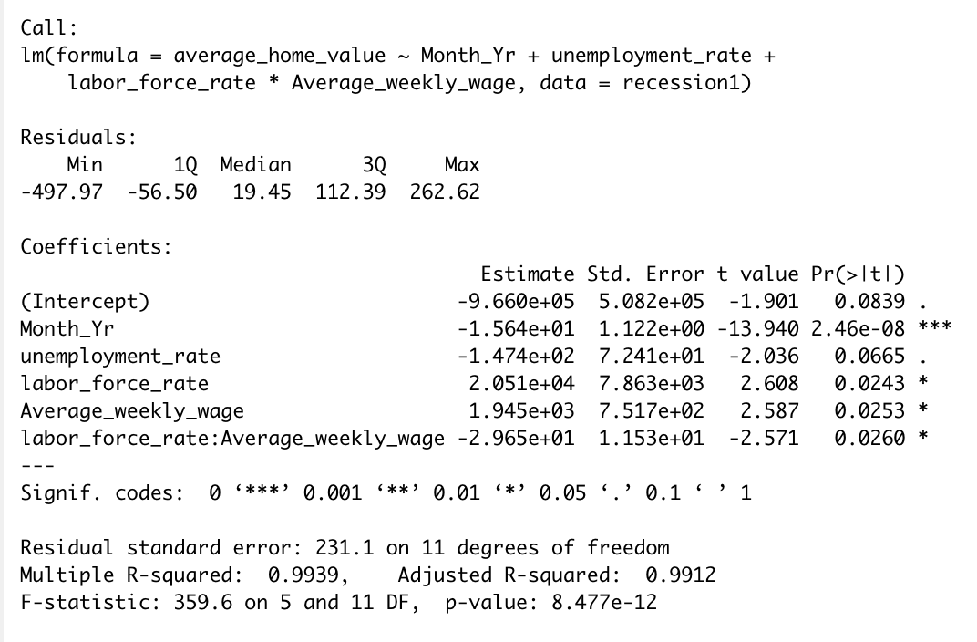
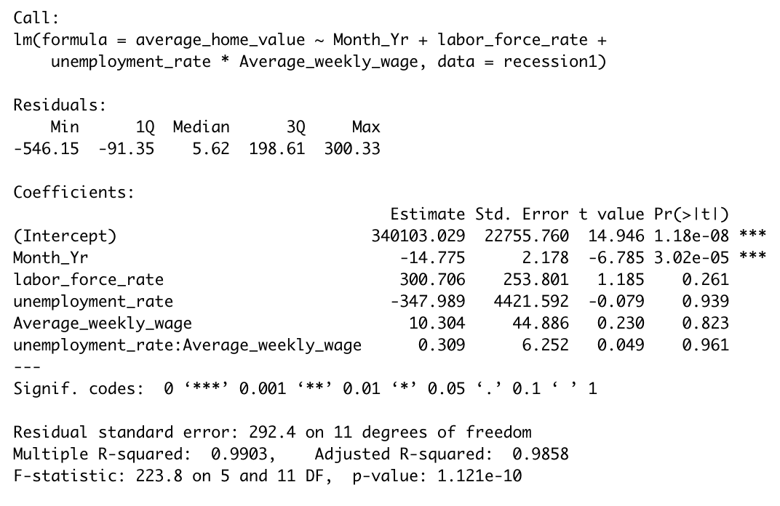
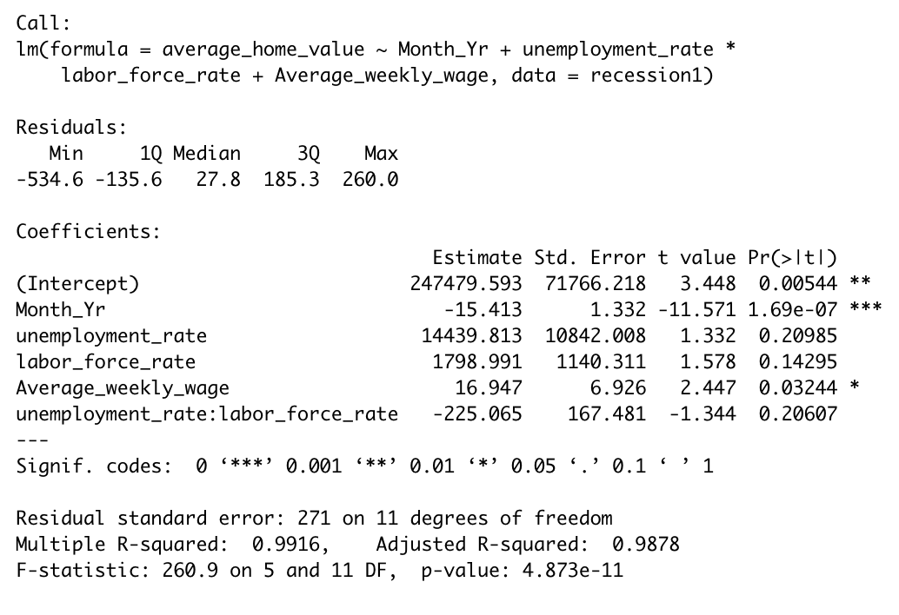
With Interaction Variable 2008 Recession
Model 2: Interaction between labor force and Avg. Weekly Wage
Model 1: Interaction between Unemployment and Avg. Weekly Wage
Model 3: Interaction between Unemployment and labor force

Slide 18
Conclusion
Model 2: With interaction variable between average weekly wage and labor force is the best model to use due to highest R-squared value
R²=0.87,0.99
Could help gain insights into how economic conditions impact the housing market in the future
Help house buyers/sellers better understand the best set of conditions to buy/sell house
Help government agencies plan ahead to prepare for potential incoming housing crisis

Slide 19
Limitations
Analysis was compared to only one past economic recession
Other confounding variables that can affect housing markets
Notes:
Could be short sighted
Other variables such as house availability etc.. could also affect the market
Multi-Collinearity in the model

Slide 20
References
Apartment Guide. (2020, September 23). Rent Report: The State of the Rental Market. Retrieved October 14, 2020, from https://www.apartmentguide.com/blog/apartment-guide-annual-rent-report/
Andrews, J. (2020, July 23). Home Prices May Be Dropping Soon. Here's Why. Retrieved October 15, 2020, from https://archive.curbed.com/2020/7/23/21333325/housing-market-real-estate-prices-coronavirus
Assessing the Economic Impacts of COVID-19 on North Carolina’s Small Business Community APRIL 2020 RESEARCH REPORT. (2020). Retrieved October 14, 2020, from http://carolinasmallbusiness.org/wp-content/uploads/2020/04/COVID-19-NC-Small-Business-Impacts-Report.pdf
Sessoms, B. (2020, September 28). Thousands of North Carolina residents fell through crack between eviction halts. Retrieved October 14, 2020, from https://www.citizen-times.com/story/news/local/2020/09/28/north-carolina-landlords-filed-more-than-18-000-eviction-orders-just-two-months/3529116001/
U.S. Bureau of Labor Statistics, Unemployment Rate in North Carolina [NCUR], retrieved from FRED, Federal Reserve Bank of St. Louis; https://fred.stlouisfed.org/series/NCUR,October 14, 2020.
Yale, A. (2020, August 10). Will Home Prices Drop During the 2020 Recession? Retrieved October 15, 2020, from https://www.thebalance.com/when-will-housing-prices-drop-again-4773140
ZHVI All Homes (SFR, Condo/Co-op) Time Series, Smoothed, Seasonally Adjusted ($), Metro & U.S. (2020). Zillow Housing Data. Retrieved October 15, 2020, from https://www.zillow.com/research/data/.

